Slide 1

AFS-220 Capstone
Creator: Jenni Hupp

Slide 2
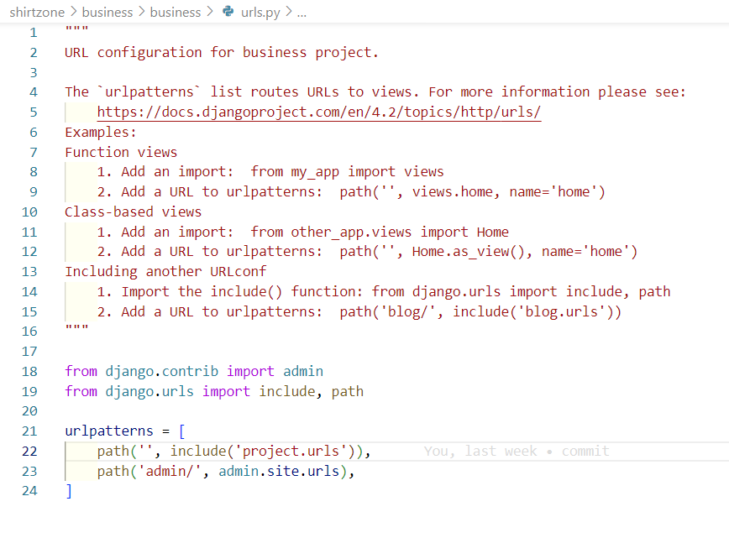
URL Configuration
In this step I setup the URL configuration for my project. This defines the connection of the pages.

Slide 3
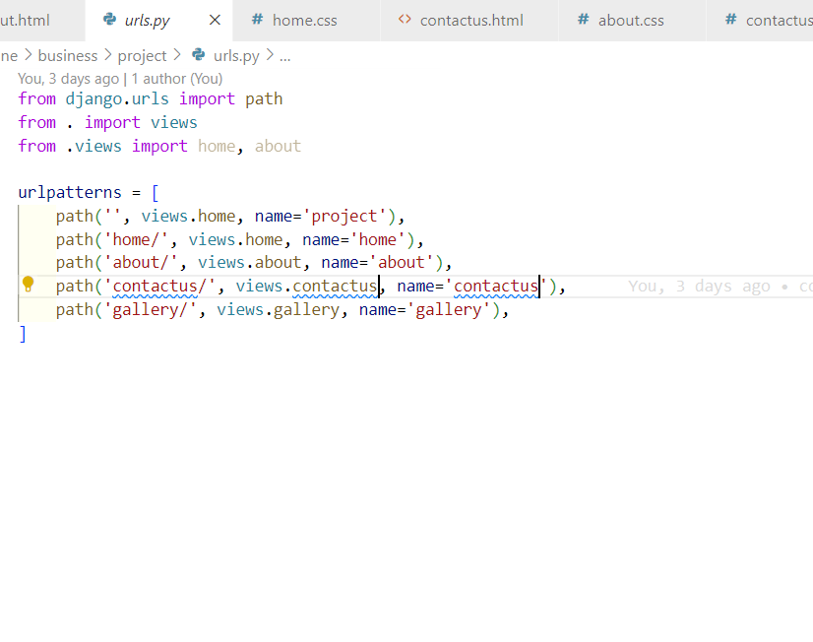
Configuration of URL paths.
The URL path is the path a browser will follow in your site's domain hierarchy to find a specific piece of content.

Slide 4
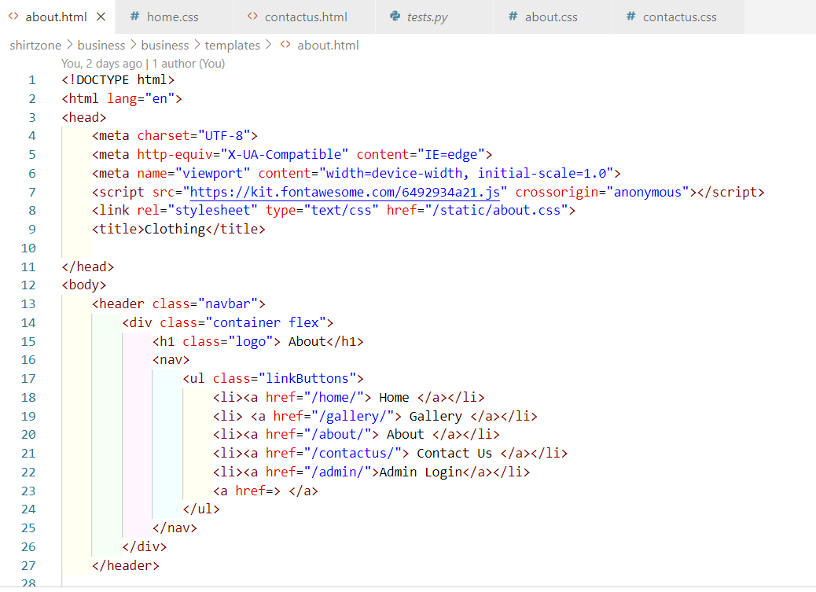
HTML Pages
The HTML pages allows the creation and structure of sections, paragraphs, and links using HTML elements (the building blocks of a web page) such as tags and attributes.

Slide 5
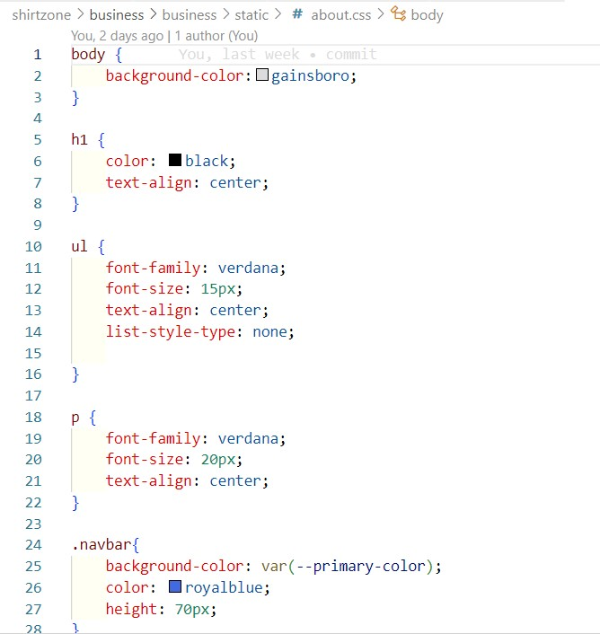
CSS Pages
CSS pages allows for the design and layout of the page to flow smoothing, whether on a computer monitor, tablet or smart phone.

Slide 6
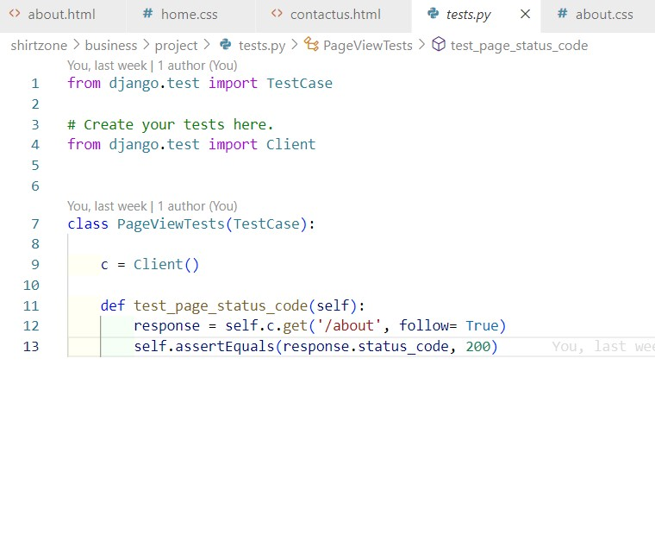
Test page
The test page allows you to test your site before building the whole project then detecting errors after. It makes the process of building the page error free much easier.

Slide 7
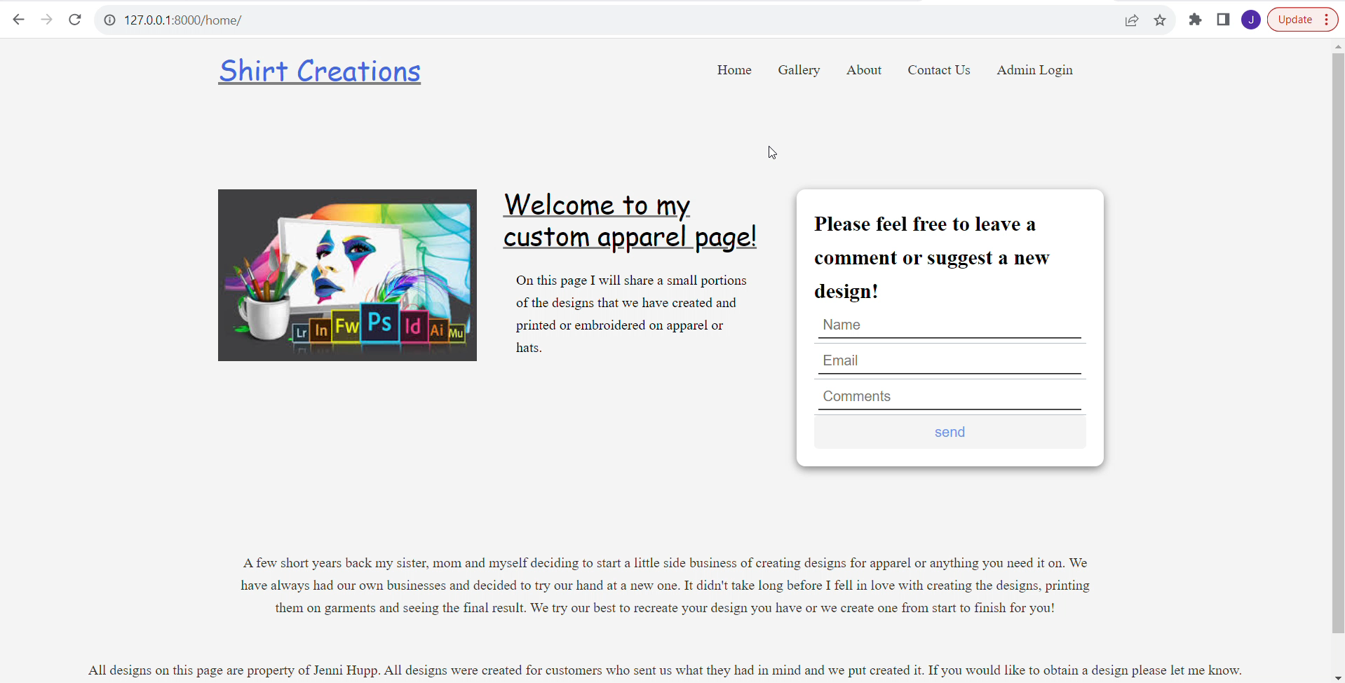
Summary, Result
The final outcome of my project. A lot of work goes into creating a site, all while managing different pages of the project to ensure that everything flows smoothly.

